Slide 1
F&B
Brand Guidelines
IBERICO RESTAURANT

Slide 2
What is Iberico?
We are IBERICO!
IBERICO was founded in 2021 and rapidly expanded to two branches in Ho Chi Minh City. After three years, we opened a new branch in Hoi An in May 2024.
Our bar and restaurant offer Spanish cuisine and wine. We pride ourselves on being creative, warm, and delicious.
Unique culinary rendezvous from Spain
The music, atmosphere, staff, and especially the culinary quintessence at Iberico will take you through the air to Spain with exquisite and perfect experiences not found everywhere.
Iberico is proud to offer one-of-a-kind and valuable Spanish culinary experiences. It is the ideal rendezvous for you. Book a table to discover now, friends!

Slide 3
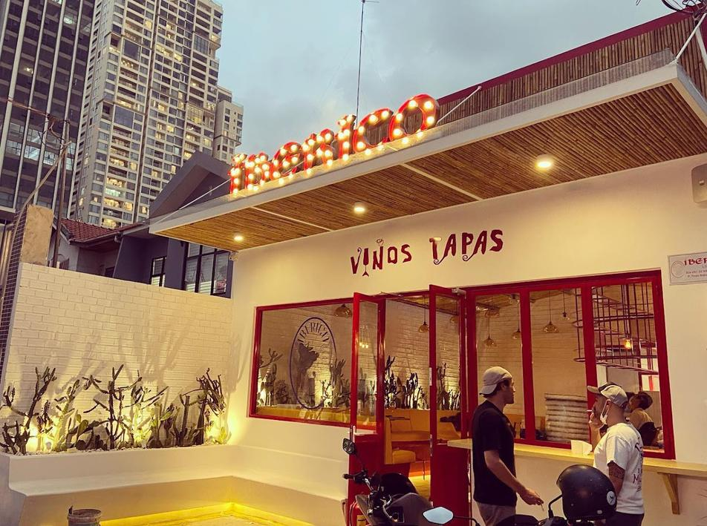
Branches
01
  Location: Thao Dien
  Opening Hours: 11:30 - 23:30
  Capacity: 60 pax
  Ambience and Atmosphere:
Nestled in a residential neighborhood popular with expats, our restaurant offers a warm and welcoming atmosphere. Whether you're dining with friends, family, or a special someone, our indoor and outdoor seating options cater to every occasion.
  Gần khu dân cư, khu expat sinh sống. Khách chủ yếu là người sinh sống ở khu vực đó. Không gian trong nhà và ngoài trời, phù hợp cho cả nhóm khách lớn, gia đình, bạn bè, lẫn cho khách đôi, hẹn hò lãng mạn.

Slide 4
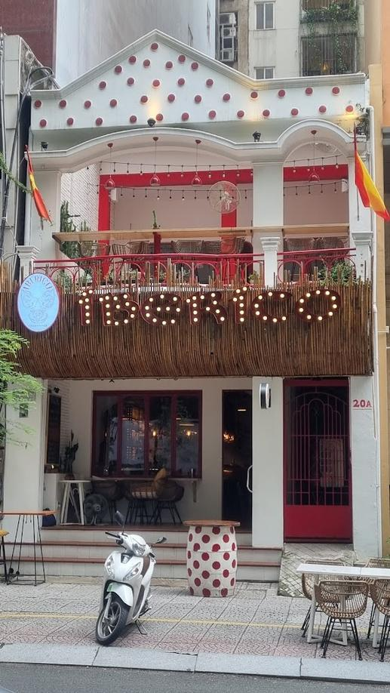
Branches
02
  Location: Thi Sách
  Opening Hours:
  Mon - Fri: 12:00 - 00:00
  Sat - Sun: 16:00 - 00:00
  Capacity: 60 -80 pax
  Ambience and Atmosphere:
Conveniently located near business districts and popular tourist destinations, our restaurant is a popular choice of travelers. In this branch, we offers a private upstairs space, perfect for hosting exclusive events.
  Gần các cao ốc văn phòng, khách sạn, khu người Nhật. Khách chủ yếu là dân văn phòng, khách du lịch vãng lai. Khách Nhật chiếm tỉ lệ cao. Thường là nhóm khách văn phòng từ tầm trung trở lên.

Slide 5
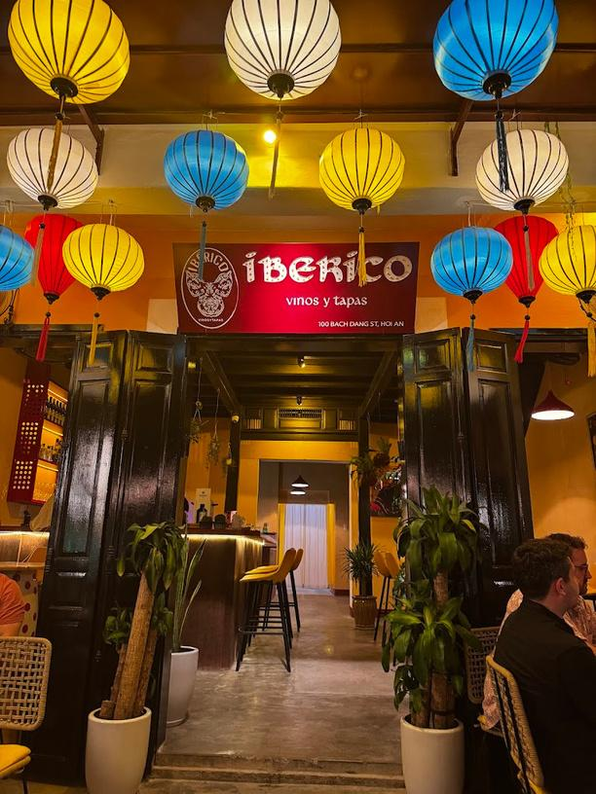
Branches
03
  Location: Hội An
  Opening Hours: 10:00 - 00:00
  Capacity: 70 pax
  Ambience and Atmosphere:
Located on the riverbank, our restaurant offers breathtaking panoramic views. Enjoy a delightful meal at our restaurant, just steps away from the famous bridge - Chùa Cầu Bridge in the ancient town Hoi An.
  Đối diện khu vực bờ sông. Nhắm đến du khách và người nước ngoài sinh sống tại Hội An Đà Nẵng. Khách Nhật và Hàn cũng được nhắm đến.

Slide 6

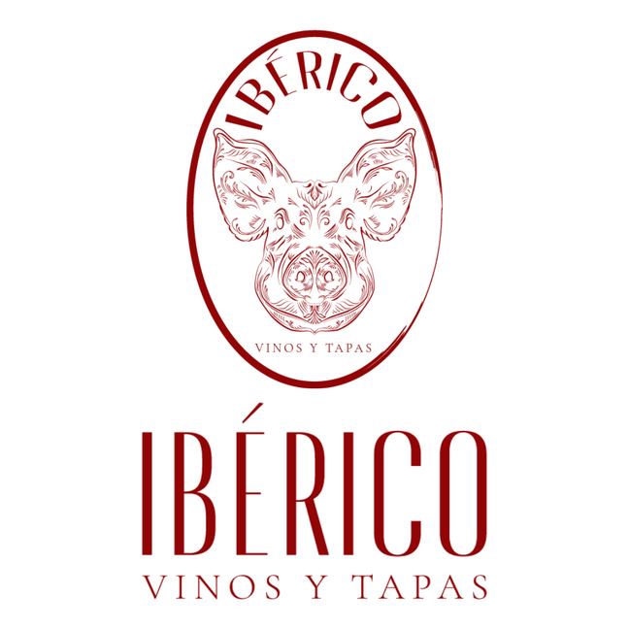

Logo
Round Logo
Lettering Logo

Slide 7





Patterns

Slide 8
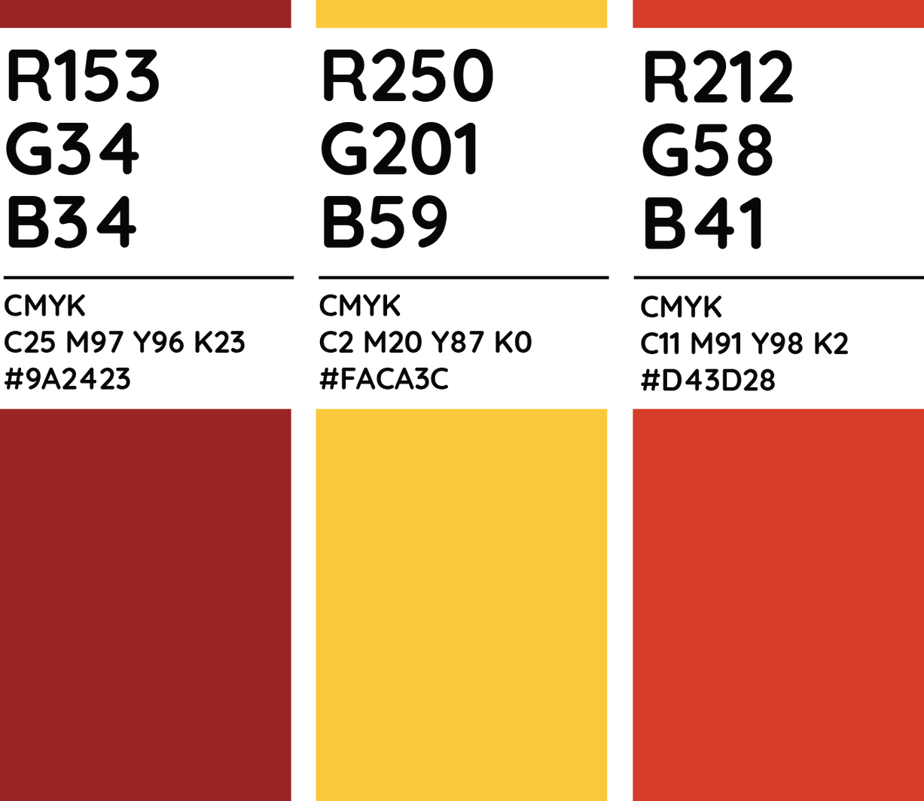
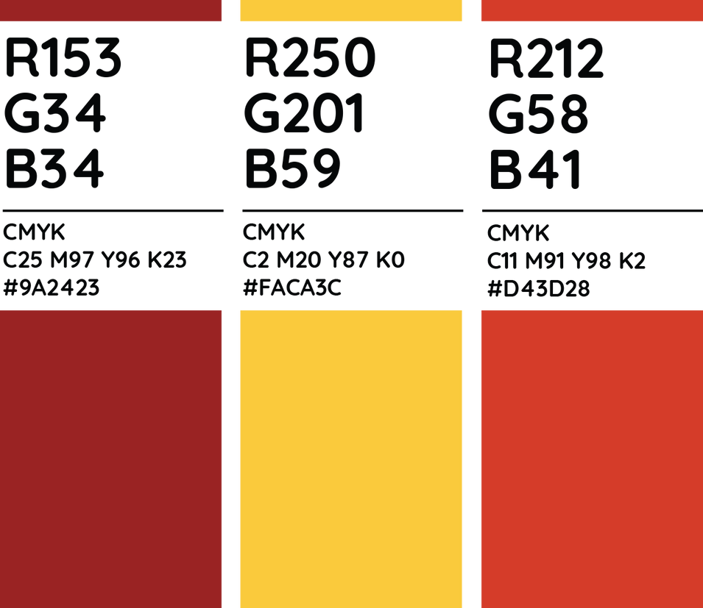
Primary Palette

Slide 9
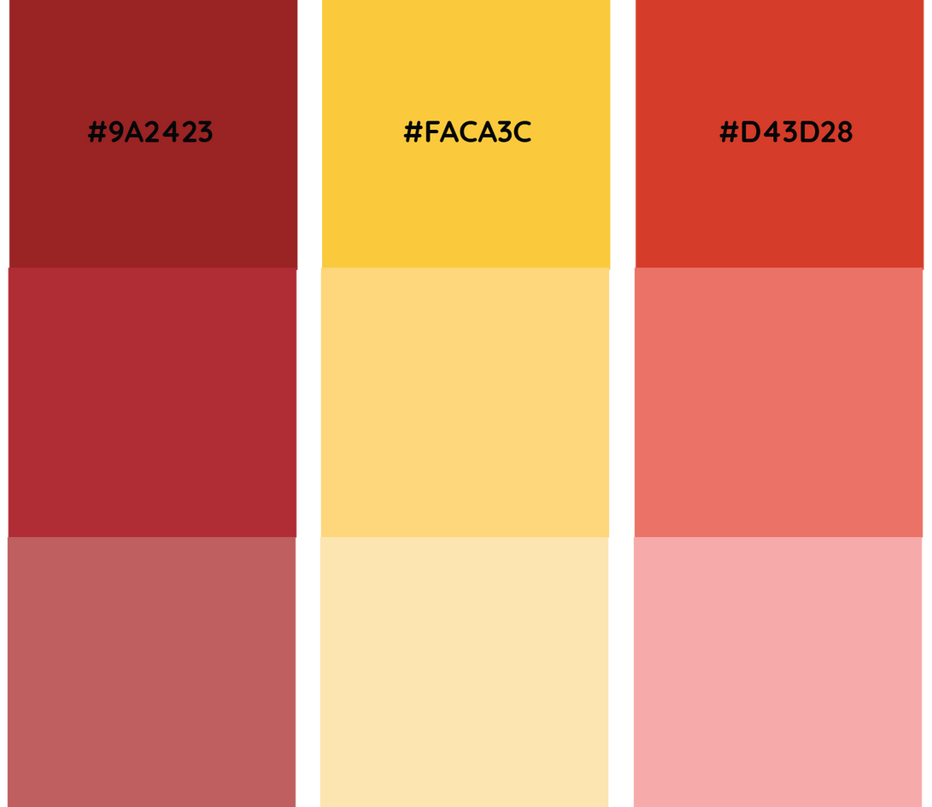
Secondary Palette

Slide 10
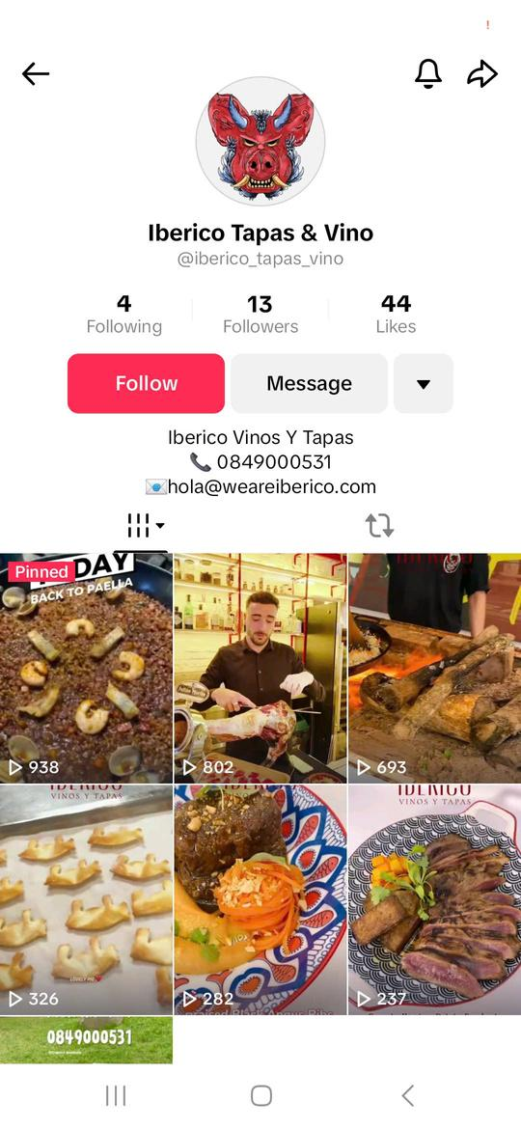
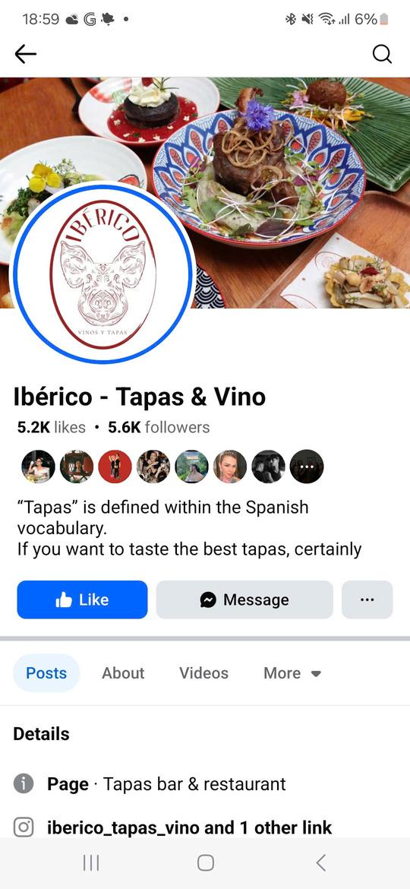
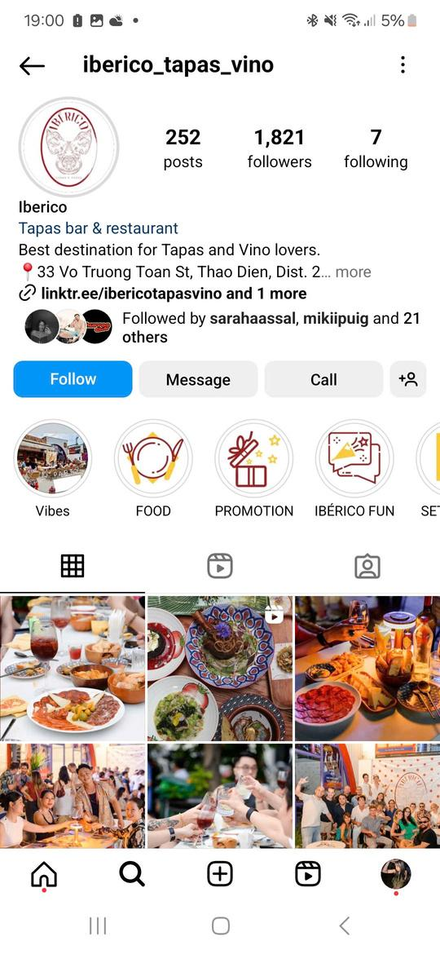
Current Platforms

Slide 11


CONTENT STRATEGY

Slide 12
Target Audiance
Objective
Increase brand awareness among local Vietnamese customers (middle to upper-middle class office workers aged 25-50) while maintaining engagement with loyal customers. The focus is on showcasing authenticity, fun vibes, educating locals on Spanish cuisine and the unique tapas experience.
Target Audience
IDemographics:
  Age: 25-50 years old
  Location: Ho Chi Minh City, Vietnam
  Income: Middle to upper-middle class (willing to spend on quality dining and drinks)
  Occupation: Office workers, professionals, Business workers, travelers
Psychographics:
  Enjoy dining out and socializing with friends.
  Interested in authentic international cuisines.
  Appreciate a vibrant and fun atmosphere.
  Value quality over quantity and are willing to pay for a unique dining experience.
  Curious about new cultures and dining experiences.
  Enjoy quality drinks
  Enjoy luxurious food

Slide 13
Key Content Themes
A. Educational Content:
  Tapas 101: Explain the culture of Spanish tapas and how to enjoy them. Use Vietnamese captions and subtitles for videos.
  Dish Spotlights: Highlight key Spanish dishes and menu dive. Include Vietnamese descriptions.
  Spanish Drinking Culture: Showcase traditional Spanish drinks like sangria, cava, or vermouth, explaining how they pair with tapas and why they are a must-try. Focus on food and drinks pairing.
B. Fun and Engaging Content:
  Behind-the-Scenes: Show chefs preparing tapas or bartenders crafting drinks, with commentary in both English and Vietnamese.
  Customer Spotlights: Feature loyal customers, especially locals, sharing their experiences.
  Interactive Posts: Create polls like "What’s your favorite tapas dish?" or quizzes like "Which Spanish drink suits your personality?"
  Spanish Culture: Highlight Spanish traditions, music, or festivals, tying them to Vietnamese values like gatherings and celebrations. Showcase the similarity in the cultures.

Slide 14
Key Content Themes
C. Authenticity and Brand Story:
  Emphasize the use of authentic Spanish ingredients and traditional preparation methods.
  Share the story of the restaurant’s journey, emphasizing its commitment to bringing a slice of Spain to Vietnam.
D. Promotions and Offers:
  Two special menus a month (Every two weeks)
E. Event Highlights:
  One or two events monthly.

Slide 15
Content Types
  1. Visual Posts (Instagram/Facebook)
  2. Stories:
Real-time updates (e.g., today’s specials, live events).
Polls, quizzes, and countdowns for upcoming events, in Vietnamese to increase engagement.
  3. Long-Form Content
Blog-style posts on Facebook about Spanish food culture and how it compares to Vietnamese dining experiences.

Slide 16
Ads.
  Focus on visually appealing carousel ads or video ads showcasing vibrant dishes, with captions in Vietnamese.
  Include clear CTAs like "Book Your Table Now" or "Enjoy Tapas Like Never Before."
  Ads will run once a month for 7 days. Budget is 800,000 to 1,000,000
  Ads will run through Meta.
Advertising Strategy
  A. Target Audience for Ads:
Location: Ho Chi Minh City
Interests: Spanish food, tapas, wine, dining out, nightlife, and international cuisines.
Demographics: Ages 25-50, middle to upper-middle class.
  B. Types of Ads:
Carousel Ads: Showcase multiple dishes and drinks with vibrant visuals.
Video Ads: Highlight the ambiance, live events, and food preparation.
  C. Budget Allocation:
100% to Instagram and Facebook ads (brand awareness).

